Slide 1


Weekly Report NTUA 10/4/2020
George Bakas

Slide 2
Status Report
Analysis:
Unfolding:
Rebin in the reco level:
Reco bins ≈ 2 x Parton/Particle Bins
Merge bins at the edge of phase space (jetPt1, ptJJ, mJJ)
Unfolding using MC (closure test)
Parton level
Particle level
Unfolding implementing the “Minimum of global Correlation”
Unfolding Errors
Calculation before and after unfolding

Slide 3
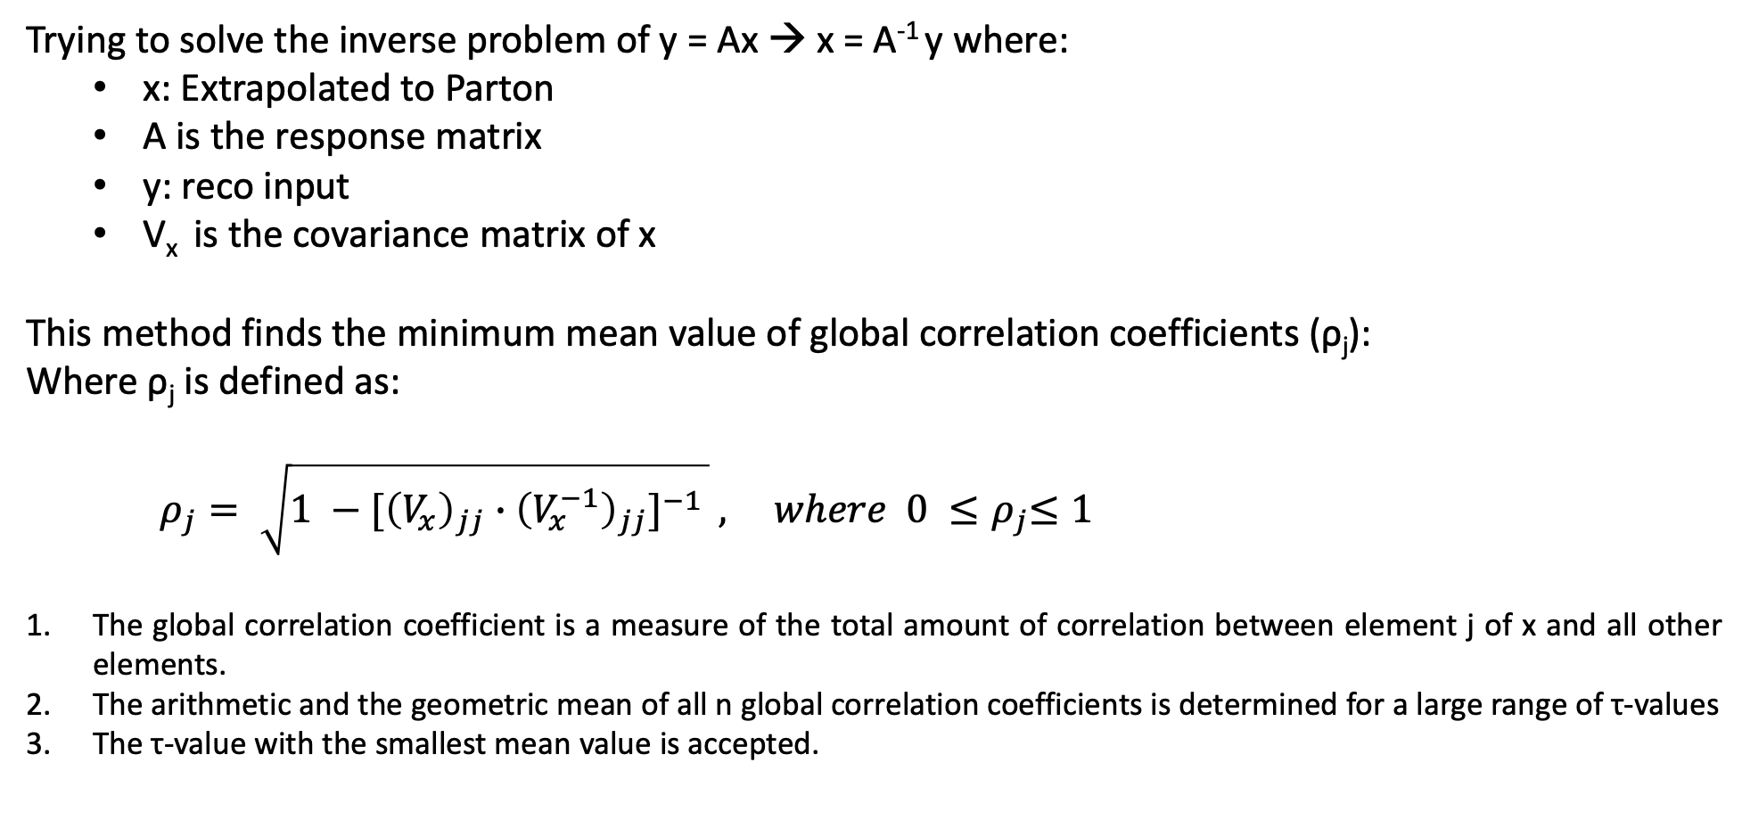
Minimum of global Correlation
Trying to solve the inverse problem of y = Ax → x = A⁻¹ y where:
x: Extrapolated to Parton
A is the response matrix
y: reco input
V_{x} is the covariance matrix of x
This method finds the minimum mean value of global correlation coefficients (ρ_{j}):
Where ρ_{j} is defined as:
$ρ_{j}= \sqrt{1 −{[\left(V_{x}\right)}_{jj} ∙{\left(V_{x}^{−1}\right)}_{jj}]^{−1 }} , where 0 {≤ρ}_{j}≤1$
The global correlation coefficient is a measure of the total amount of correlation between element j of x and all other elements.
The arithmetic and the geometric mean of all n global correlation coefficients is determined for a large range of τ-values
The τ-value with the smallest mean value is accepted.

Slide 4
Minimum of global Correlation (MC Parton)
Leading Jet Pt
Leading Jet |Y|

Slide 5
Minimum of global Correlation (Data Parton)
Leading Jet Pt
Leading Jet |Y|

Slide 6
Parton level
Simple matrix inversion
Minimum of Global Correlation

Slide 7
Parton level MC
Simple matrix inversion
Minimum of Global Correlation

Slide 8
Parton level
Simple matrix inversion
Minimum of Global Correlation

Slide 9
Parton level MC
Simple matrix inversion
Minimum of Global Correlation

Slide 10
Particle level
Simple matrix inversion
Minimum of Global Correlation

Slide 11
Particle level MC
Simple matrix inversion
Minimum of Global Correlation

Slide 12
Particle level
Simple matrix inversion
Minimum of Global Correlation

Slide 13
Particle level MC
Simple matrix inversion
Minimum of Global Correlation

Slide 14
Error Propagation Data
MC
Data

Slide 15
Error Propagation Data
MC
Data

Slide 16
BACKUP

Slide 17
Error Propagation Data
MC
Data

Slide 18
Error Propagation Data
MC
Data

